Slide 1
Corsica simulation of ITER hybrid mode operation scenario
S.H. Kim and T.A. Casper
ITER Organization, St Paul lez Durance, France
Acknowledgement : LLNL, ITER/Monaco
R.H. Bulmer, L. LoDestro, W. Meyer and D. Pearlstein (LLNL) – Corsica collaboration
J. Garcia (CEA), M. Henderson (ITER), C.E Kessel (PPPL) and T. Oikawa (ITER)
– useful discussions

Slide 2
Introduction & outline
Simulations of ITER hybrid and steady-state mode operations are requested to support several tasks for resolving ITER physics and engineering issues.
Feasibility of achieving physics goals, such as Q and plasma burn duration
Heating and current drive requirements, and profile tailoring
Plasma control system, coils and power supplies
Realistic source modules (NB/EC/LH/IC) are recently either upgraded or added, and their operating parameters are determined reflecting recent ITER design changes.
Source modules for Corsica simulation
Backing-out simulation of ITER hybrid mode operation
Forward simulation of ITER hybrid mode operation
Summary and perspectives

Slide 3
Corsica source modules
NB : Nfreya, MC code for heating and current drive, an existing module in Corsica package, updated beam parameters (T. Oikawa)
EC : Toray-GA, ray-tracing wave code, v1.8 (GA, R. Prater), 5 EC launchers, updated launcher parameters (M. Henderson),
3 EL , co-EL (upper, 1), counter-EL (middle, 2) and co-EL (lower, 3), and 2UL, USM (4) and LSM (5). Each launcher can deliver 6.67MW .
Automatic scan on the poloidal and toroidal angles has been developed to find required mirror angles.
LH : LSC, ray-tracing wave code (NTCC), TSC ITER simulation setting (C. Kessel)
ICRF : Toric, Full wave code, in preparation
A version originally used for developing interface is working, but prescribed heat deposition profiles are used in this work.
No IC driven current is assumed.
ITER will have an official version soon from IPP (discussed with R. Bialto and J. Wright)

Slide 4
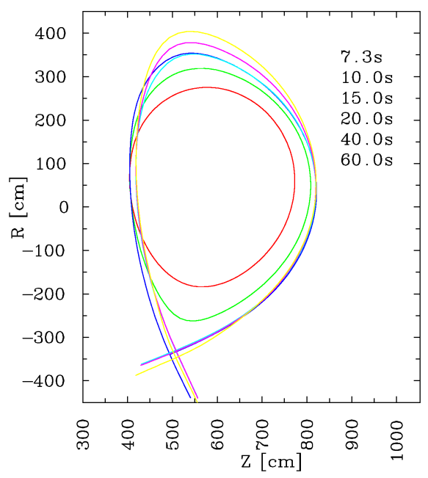
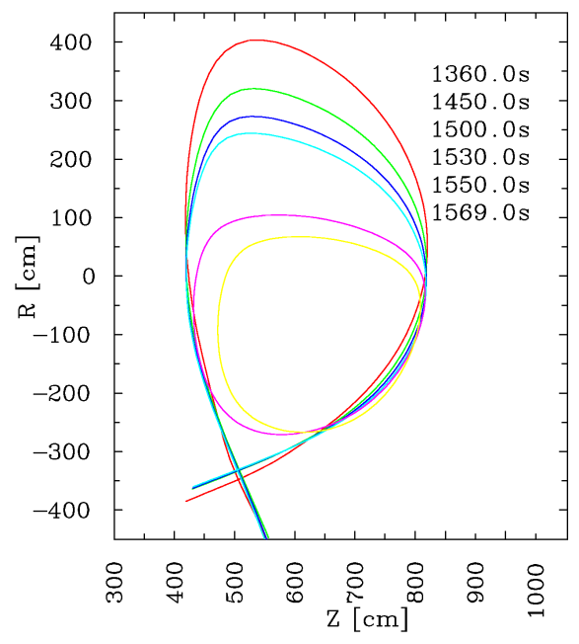
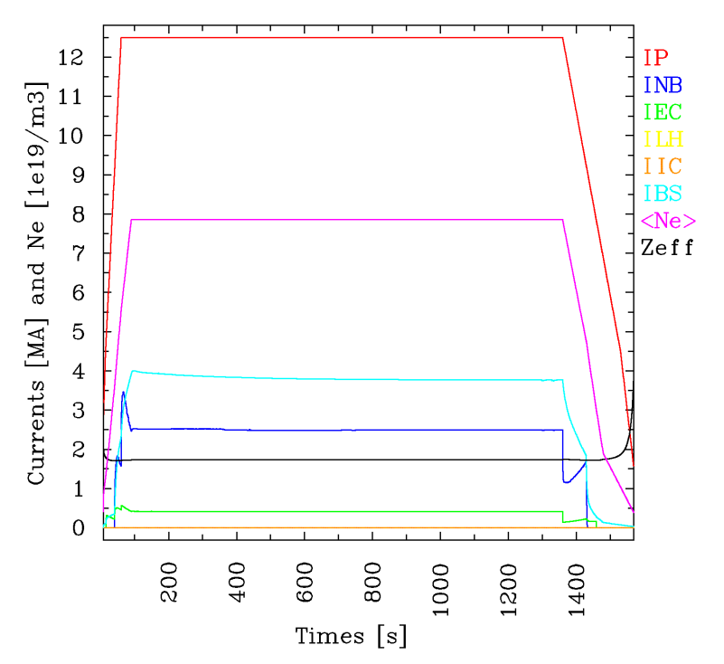
Reference simulation of ITER hybrid mode
12.5MA scenario has been developed by tailoring the 15MA scenario (T. Casper)
Large bore startup (initially inboard limiter configuration)
n_{e}(0,flat-top)=8.5e19 m⁻³ & n_{GW}~9.9e19 m⁻³
Zeff(t)~1.7+2.3*(ne0(t0)/ne0(t))^2.6 (V. Lukash)
1300s of current flat-top
60s ramp-up without pre-magnetization (XPF at about 15s and L-H transition at 40s)
210s ramp-down (H-L transition 70s after EOF, no auxiliary power 30s after H-L transition)

Slide 5
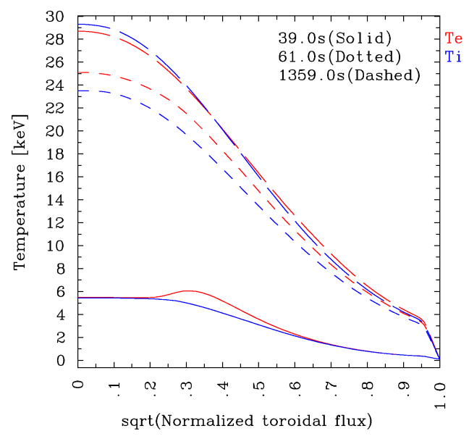
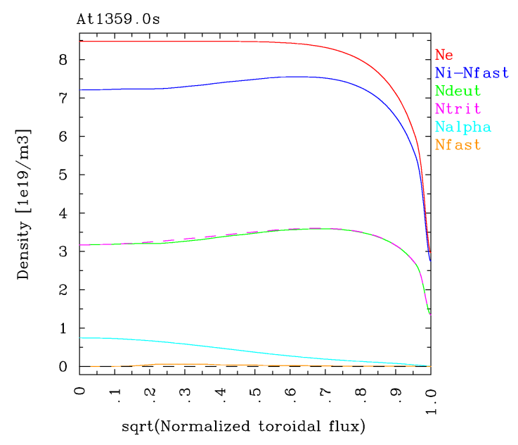
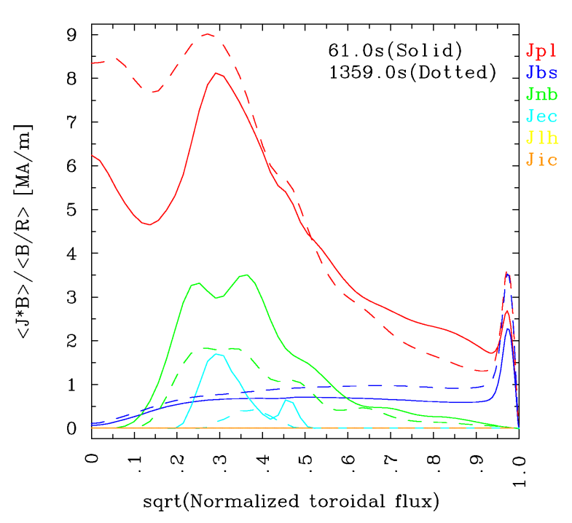
Evolution of plasma profiles
Coppi-Tang transport model with the coefficients used for 15MA H-mode simulation
Te(ped) ~ 3-4keV, ρ_{tor}(ped) ~0.95
Be and Ar impurity densities, self-consistently with Zeff(t)
33MW of NB (off-axis) & 20MW of EC (2 co-ELs and 1 UL-LSM). Source profiles are calculated at every time-step.
Effective sawteeth by increasing the heat conductivities and plasma resistivity inside the inversion radius, when q_{min}<0.97

Slide 6
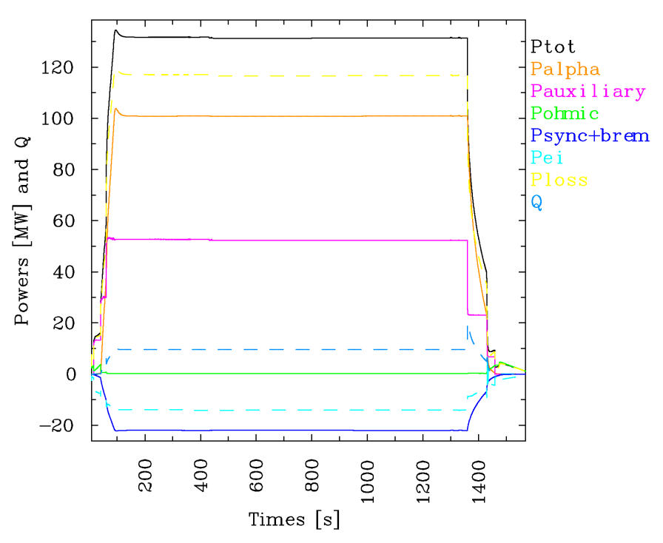
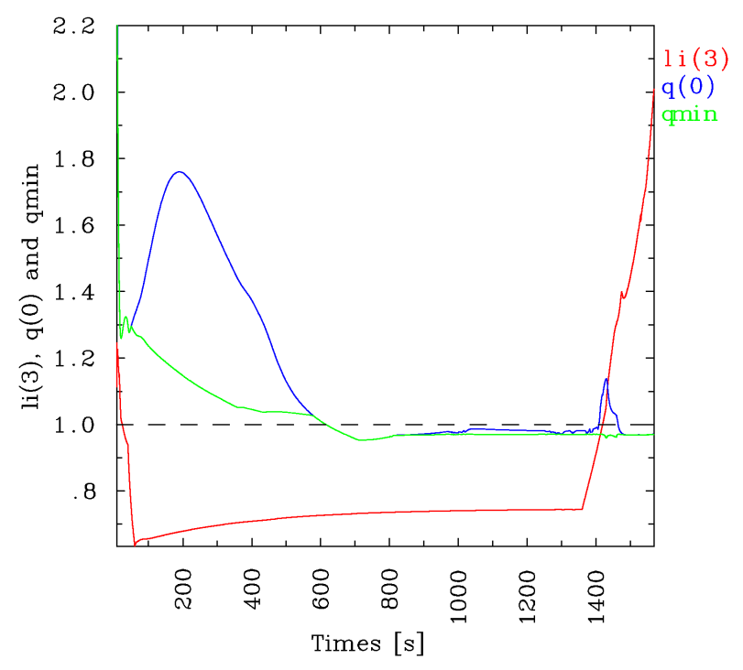
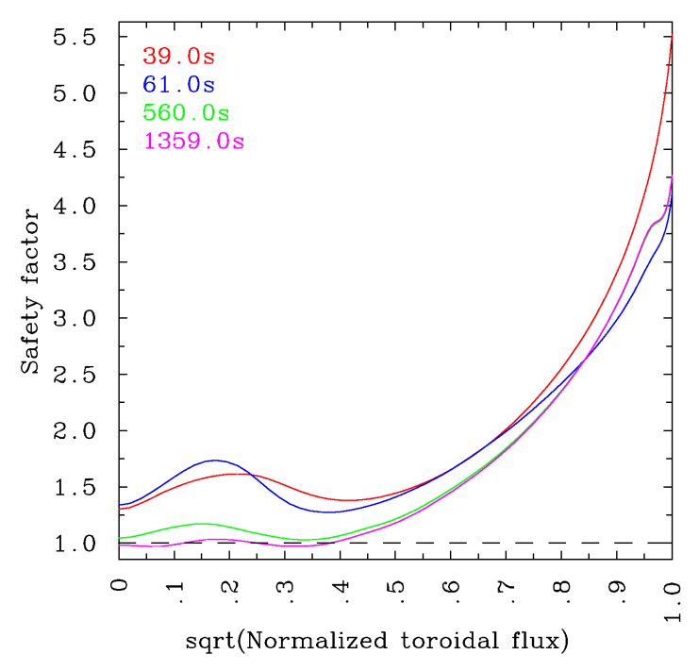
Evolution of plasma parameters
At t=1359s (tEOF = 1360s)
Q ~ 9.6 & P_{α} ~ 101MW → high Q (>5.0) with relatively low P_{aux}=53MW
H₉₈ ~ 1.24 & l_{i}(3) ~ 0.75 → improved confinement, good for the vertical stability
β_{N} ~ 2.5 & β_{p} ~ 0.82 → high betas
I_{BS} ~ 3.8MA, I_{NB} ~ 2.5MA & I_{EC} ~ 0.4MA → f_{NI} ~ 0.54 (it seems not enough for q>1.0)
q(0) ~ 0.98 & q_{min} ~ 0.97 → a slightly reversed or flat q profile inside ρ_{tor} ~ 0.4

Slide 7
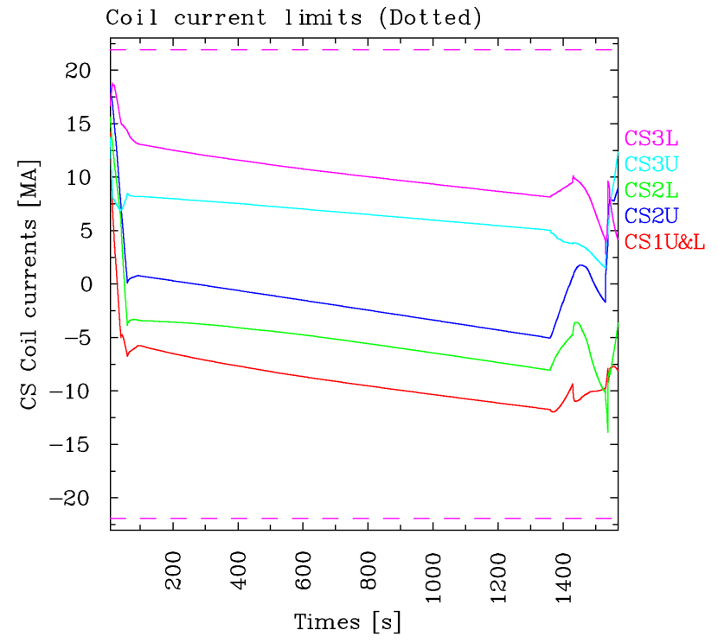
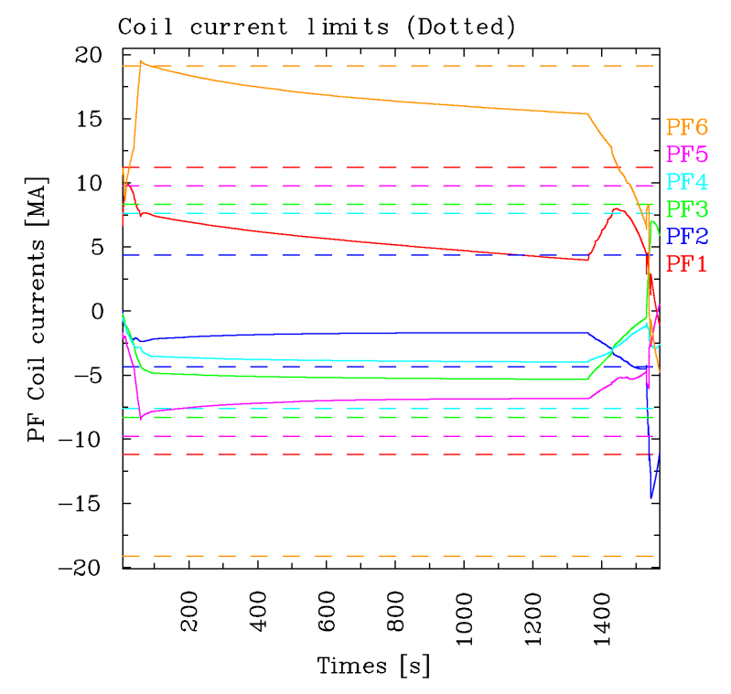
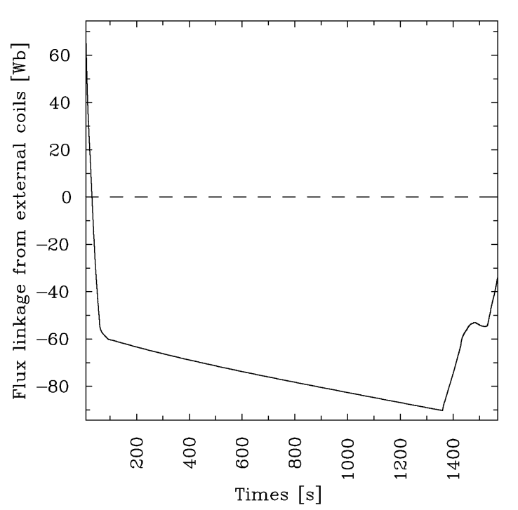
Evolution of coil currents
CS coil currents are well within the coil current limits.
PF6 coil current is briefly violating the coil current limit (~19MA at B_{max} = 6.5T without 0.4K sub-cooling ) at SOF. This is OK with UFC criteria.
PF2 coil current is violating its lower coil current limit during the ramp-down, due to the shape transition to the outboard limiter configuration (will be shown later).
The total flux consumption is well within the limit.

Slide 8
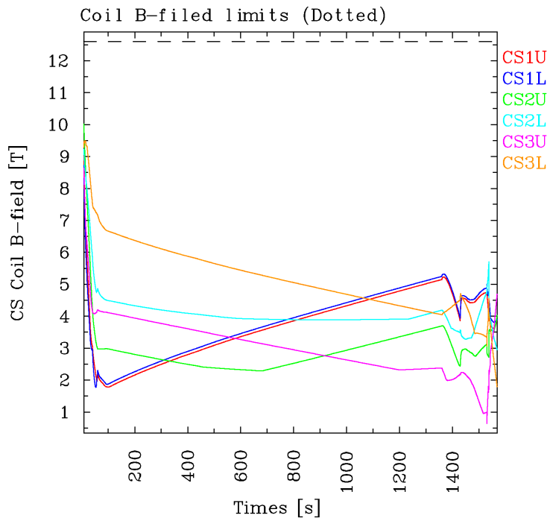
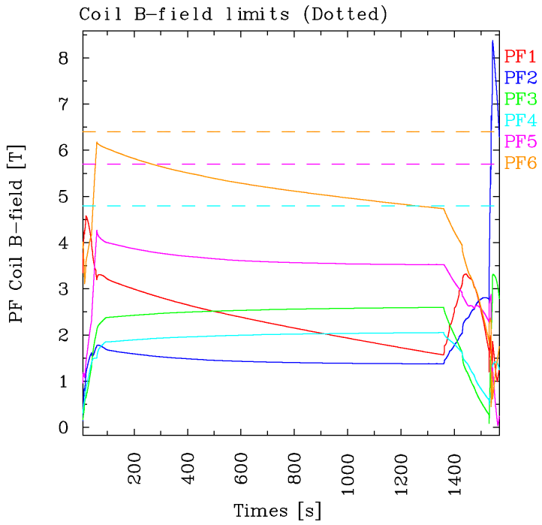
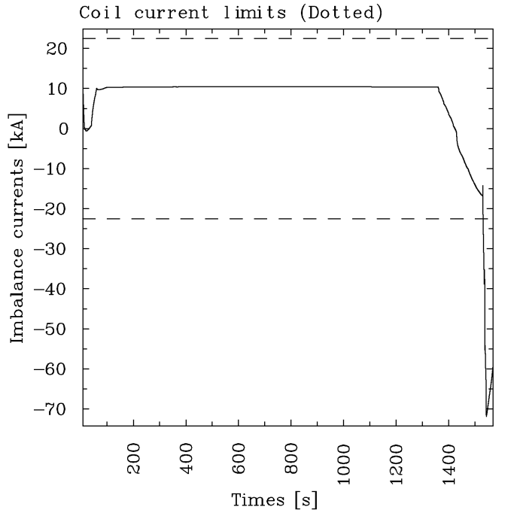
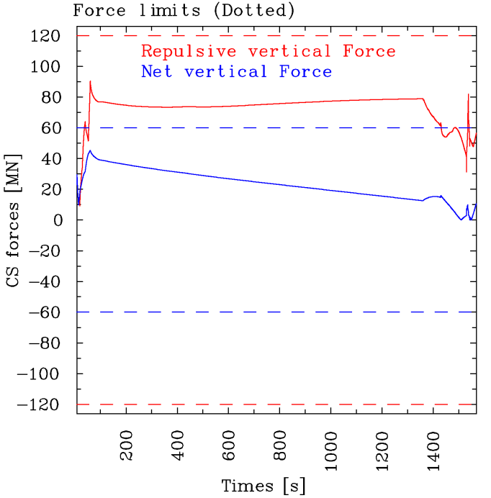
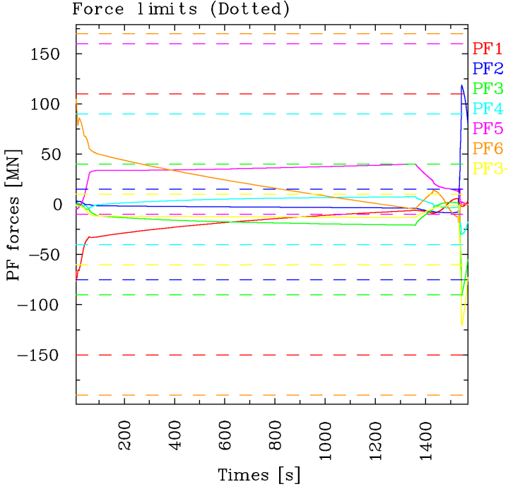
B-field, imbalance current and force limits (Ref.)
PF2 violated B-field, force and imbalance current limits during the ramp-down at about I_{p}~3.5MA with P_{aux}=0W.
It appears that PCS can handle this with no damages on the system.

Slide 9
Low density/low confinement/no Sawtooth
Application of different simulation conditions
Low density case
(ne(0,flat-top) = 7.0e19 m⁻³ (n_{e}/n_{GW}~0.7)
lower W_{th}, H₉₈, β_{N}, β_{p}, P_{α}, Q and I_{BS}
higher l_{i}, I_{NB} and I_{EC}
Low H-mode confinement case
Slightly higher L-mode confinement (Coppi-tang coef. 2.5→2.0) and slightly lower H-mod confinement (Coppi-tang coef. 1.10→1.15)
lower H₉₈, β_{N}, β_{p} and higher l_{i}
No Sawteeth case
Very similar to reference simulation except q < 0.97
Slightly different q(0) behaviours
At SOF (t=1359s) | Ref | Low dens. | Low conf. | No ST
W_{th} [MJ] | 361.3 | 296.6 (▼) | 339.9 | 361.4
H₉₈ | 1.237 | 1.187 | 1.185 | 1.238
β_{N} | 2.516 | 2.111 | 2.368 | 2.517
β_{p} | 0.815 | 0.685 | 0.768 | 0.815
l_{i}(3) | 0.745 | 0.787 (▲) | 0.741 | 0.745
q(0) | 0.982 | 1.396 | 1.376 | 0.845
q_{min} | 0.971 | 0.971 | 0.970 | 0.969
min(q) | 0.970 | 0.970 | 0.970 | 0.845
I_{BS} [MA] | 3.76 | 3.05 | 3.57 | 3.76
I_{NB} [MA] | 2.49 | 3.22 | 2.36 | 2.49
I_{EC}/I_{LH} [MA] | 0.41/- | 0.50/- | 0.41/- | 0.41/-
P_{α} [MW] | 100.9 | 68.5 | 92.2 | 101.0
P_{loss} [MW] | 116.7 | 94.3 | 110.7 | 116.7
P_{aux} [MW] | 52.30 | 52.94 | 52.64 | 52.30
Q | 9.64 | 6.46 | 8.74 | 9.65
T_{e}(0) [keV] | 28.71 | 27.07 | 27.34 | 28.97
T_{i}(0) [keV] | 29.31 | 27.84 | 27.14 | 29.24
T_{e}(0.95) [keV] | 3.56 | 3.72 | 3.41 | 3.59
Flux(t=7.33s) [Wb] | 69.89 | 69.89 | 69.89 | 69.89
Flux(SOF) [Wb] | -90.22 | -90.90 | -93.27 | -90.22

Slide 10
Premagnetization
Avoiding CS coil lower limits (consuming less flux)
Early H&CD or large bore start-up
Modified shape evolution (flux consumption re-distribution)
Avoiding PF coil upper limits (consuming more flux)
Late H&CD or small bore start-up
Slow current ramp
Modified shape evolution
Application of premagnetization (either 20Wb or 40Wb)
Very similar plasma parameters with the reference simulation
Different initial flux state, but similar flux consumption
Different coil current evolutions
At SOF (t=1359s) | ref | Pre-mag20 | Pre-mag40
W_{th} [MJ] | 361.3 | 361.5 | 361.4
H₉₈ | 1.237 | 1.238 | 1.238
β_{N} | 2.516 | 2.517 | 2.518
β_{p} | 0.815 | 0.815 | 0.815
l_{i}(3) | 0.745 | 0.743 | 0.738
q(0) | 0.982 | 0.975 | 1.041
q_{min} | 0.971 | 0.970 | 0.974
min(q) | 0.970 | 0.970 | 0.974
I_{BS} [MA] | 3.76 | 3.77 | 3.78
I_{NB} [MA] | 2.49 | 2.49 | 2.49
I_{EC}/I_{LH} [MA] | 0.41/- | 0.41/- | 0.41/-
P_{α} [MW] | 100.9 | 101.0 | 101.0
P_{loss} [MW] | 116.7 | 116.9 | 116.8
P_{aux} [MW] | 52.30 | 52.41 | 52.30
Q | 9.64 | 9.63 | 9.65
T_{e}(0) [keV] | 28.71 | 28.91 | 29.05
T_{i}(0) [keV] | 29.31 | 29.27 | 29.10
T_{e}(0.95) [keV] | 3.56 | 3.59 | 3.61
Flux(t=7.33s) [Wb] | 69.89 | 49.69 | 29.50
Flux(SOF) [Wb] | -90.22 | -110.25 | -130.23

Slide 11
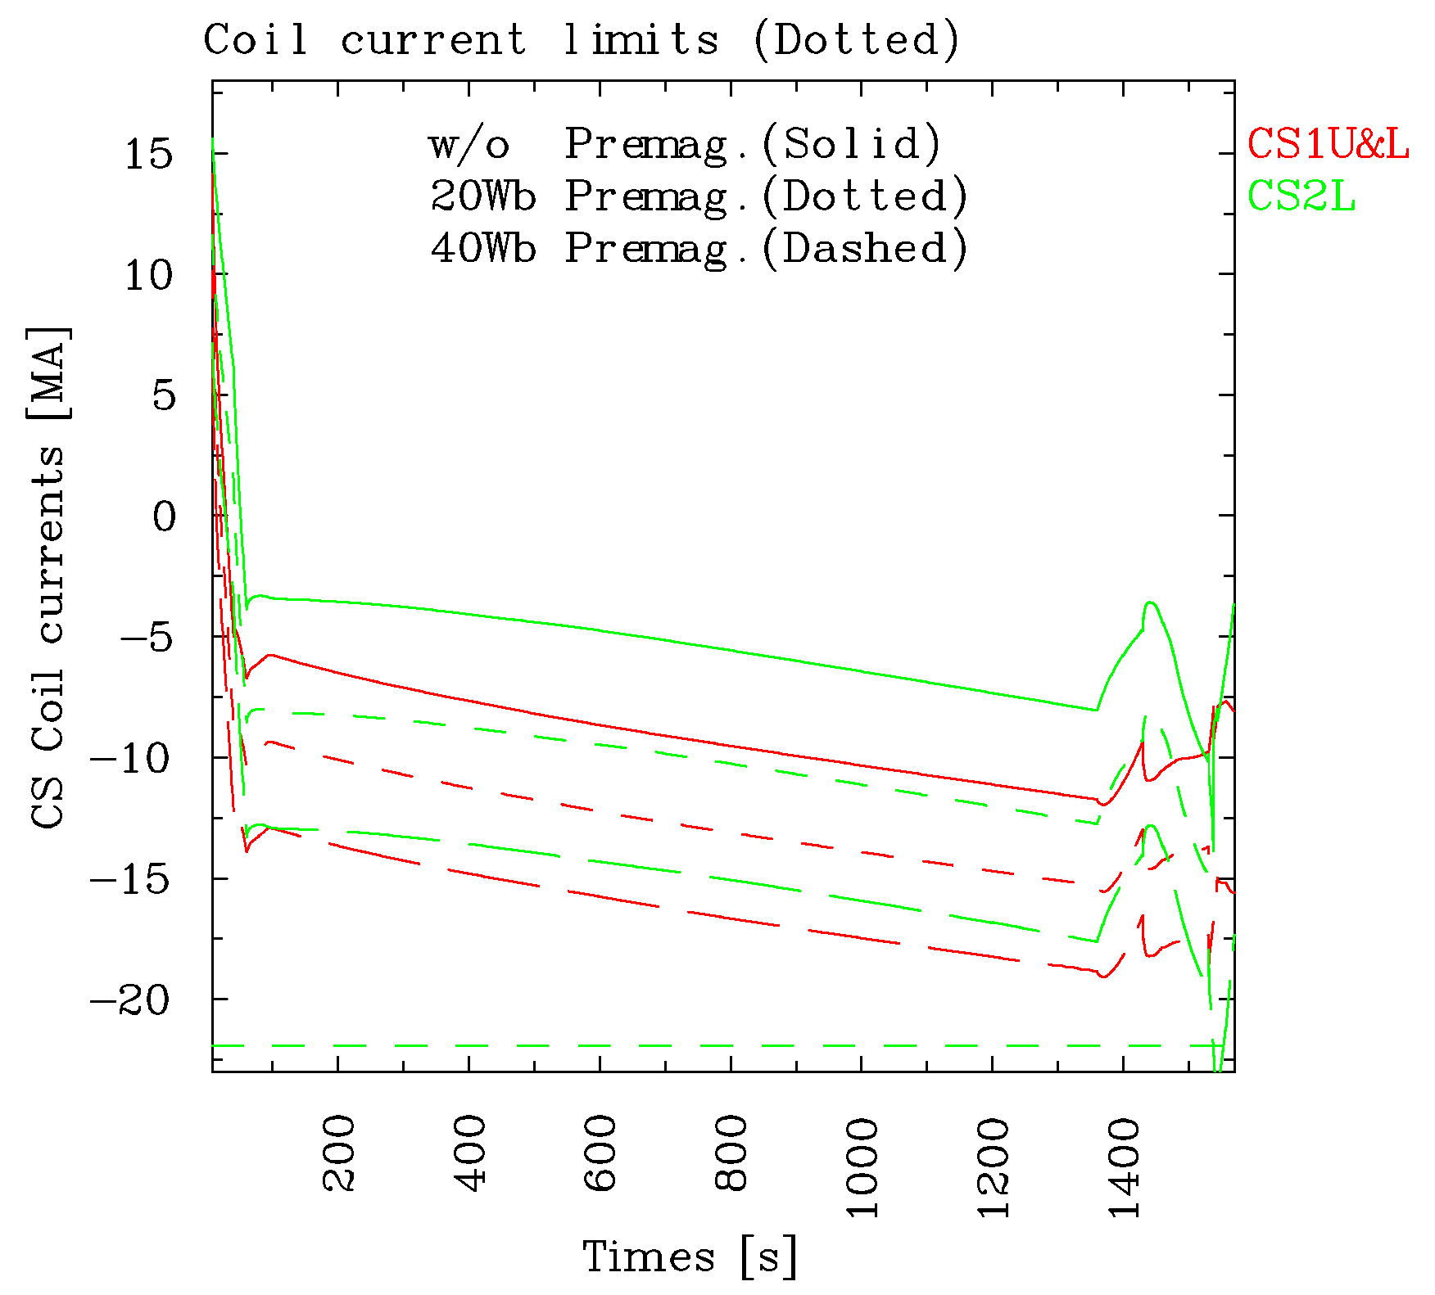
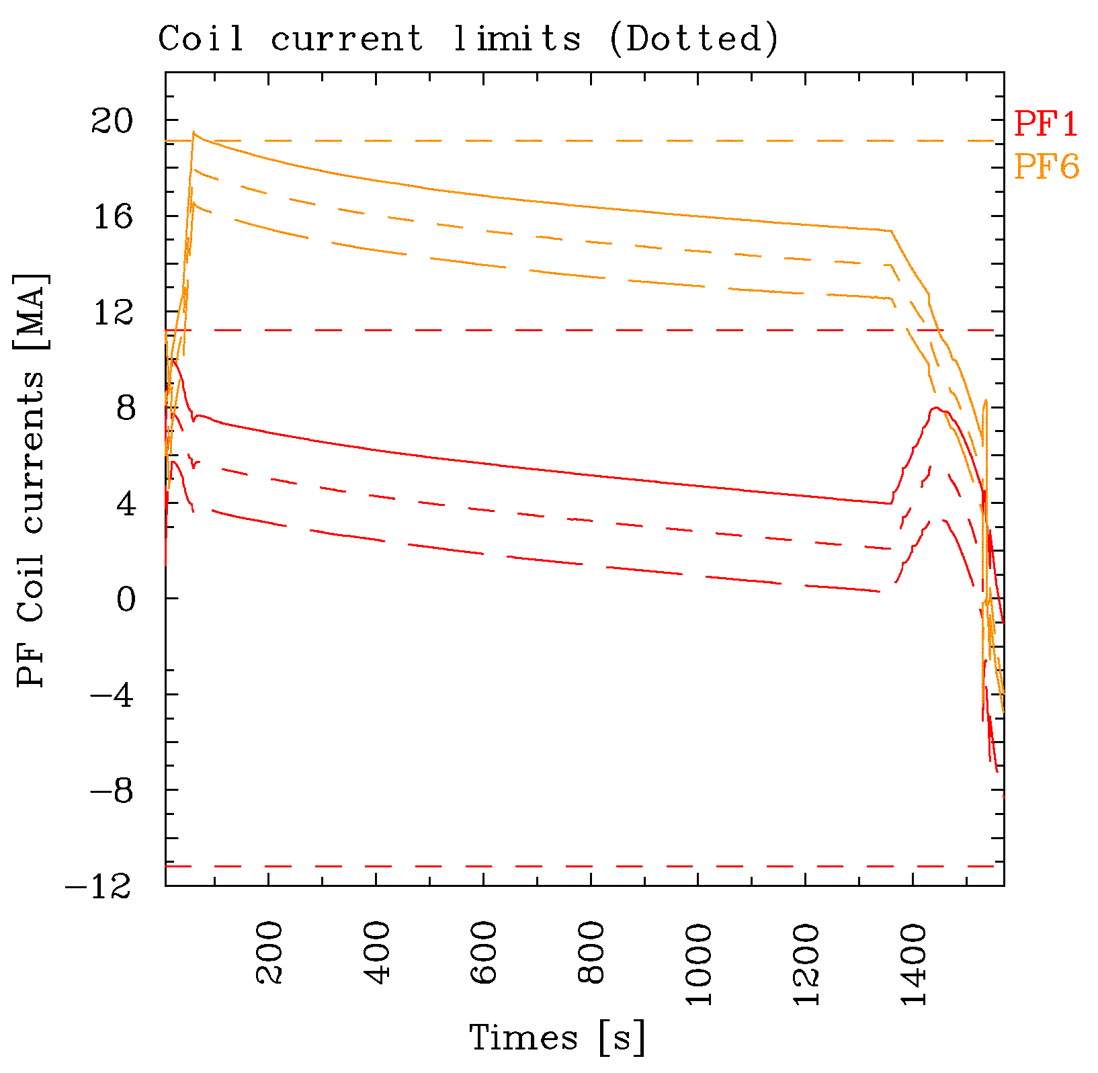
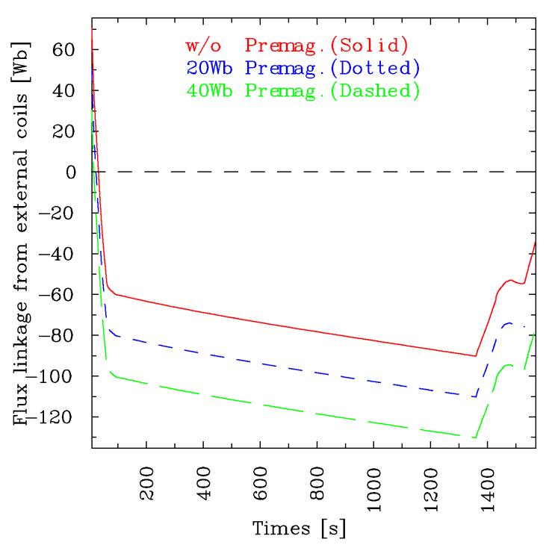
Coil current and flux state evolution
Pre-magnetization using CEQ package in CORSICA
PF6 coil current limit is avoided with premagnetization
Shift of the flux state, no additional flux consumption

Slide 12
Application of various HCD schemes
53MW (ref)
73MW (ref + 20MW)
93MW (ref + 40MW)
60MW (no NB, 2*P_{EC})
LH → lower l_{i}, q>1.0
Higher I_{ni} → lower flux consumption
Higher power → higher I_{BS}, P_{α} and lower Q
No NB (2*P_{EC}) cases similar to the reference simulation
At SOF (t=1359s) | Ref NB33/EC20 | NB33/EC40 | NB33/EC20/IC20 | NB33/EC20/LH20 | NB33/EC20/LH20/IC20 | EC40/LH20 | EC40/IC20
W_{th} [MJ] | 361.3 | 389.0 | 391.2 | 390.0 | 416.4 | 373.4 | 379.7
H₉₈ | 1.237 | 1.264 | 1.262 | 1.262 | 1.284 | 1.253 | 1.263
β_{N} | 2.516 | 2.709 | 2.722 | 2.712 | 2.888 | 2.500 | 2.545
β_{p} | 0.815 | 0.877 | 0.881 | 0.880 | 0.937 | 0.810 | 0.807
l_{i}(3) | 0.745 | 0.723 | 0.715 | 0.622 | 0.592 | 0.655 | 0.722
q(0) | 0.982 | 1.035 | 0.959 | 1.219 | 1.319 | 0.972 | 0.972
q_{min} | 0.971 | 0.987 | 0.970 | 1.087 | 1.209 | 0.970 | 0.971
min(q) | 0.970 | 0.986 | 0.959 | 1.087 | 1.208 | 0.970 | 0.971
I_{BS} [MA] | 3.76 | 4.09 | 4.10 | 4.30 | 4.65 | 4.06 | 3.95
I_{NB} [MA] | 2.49 | 2.65 | 2.62 | 2.68 | 2.72 | - | -
I_{EC}/I_{LH} [MA] | 0.41/- | 0.82/- | 0.41/- | 0.41/0.90 | 0.41/0.89 | 0.82/0.90 | 0.82/-
P_{α} [MW] | 100.9 | 110.7 | 115.7 | 111.6 | 124.7 | 102.5 | 108.4
P_{loss} [MW] | 116.7 | 142.9 | 148.7 | 143.9 | 173.8 | 123.7 | 130.2
P_{aux} [MW] | 52.30 | 72.64 | 72.65 | 72.64 | 92.31 | 59.99 | 59.99
Q | 9.64 | 7.63 | 7.97 | 7.69 | 6.76 | 8.53 | 8.93
T_{e}(0) [keV] | 28.71 | 31.61 | 31.43 | 31.32 | 32.74 | 29.85 | 30.31
T_{i}(0) [keV] | 29.31 | 30.96 | 31.96 | 30.68 | 33.05 | 29.40 | 30.38
T_{e}(0.95) [keV] | 3.56 | 3.84 | 3.83 | 3.94 | 4.04 | 3.77 | 3.70
Flux(SOF) [Wb] | -90.22 | -82.91 | -84.69 | -74.79 | -70.87 | -87.79 | -96.35

Slide 13
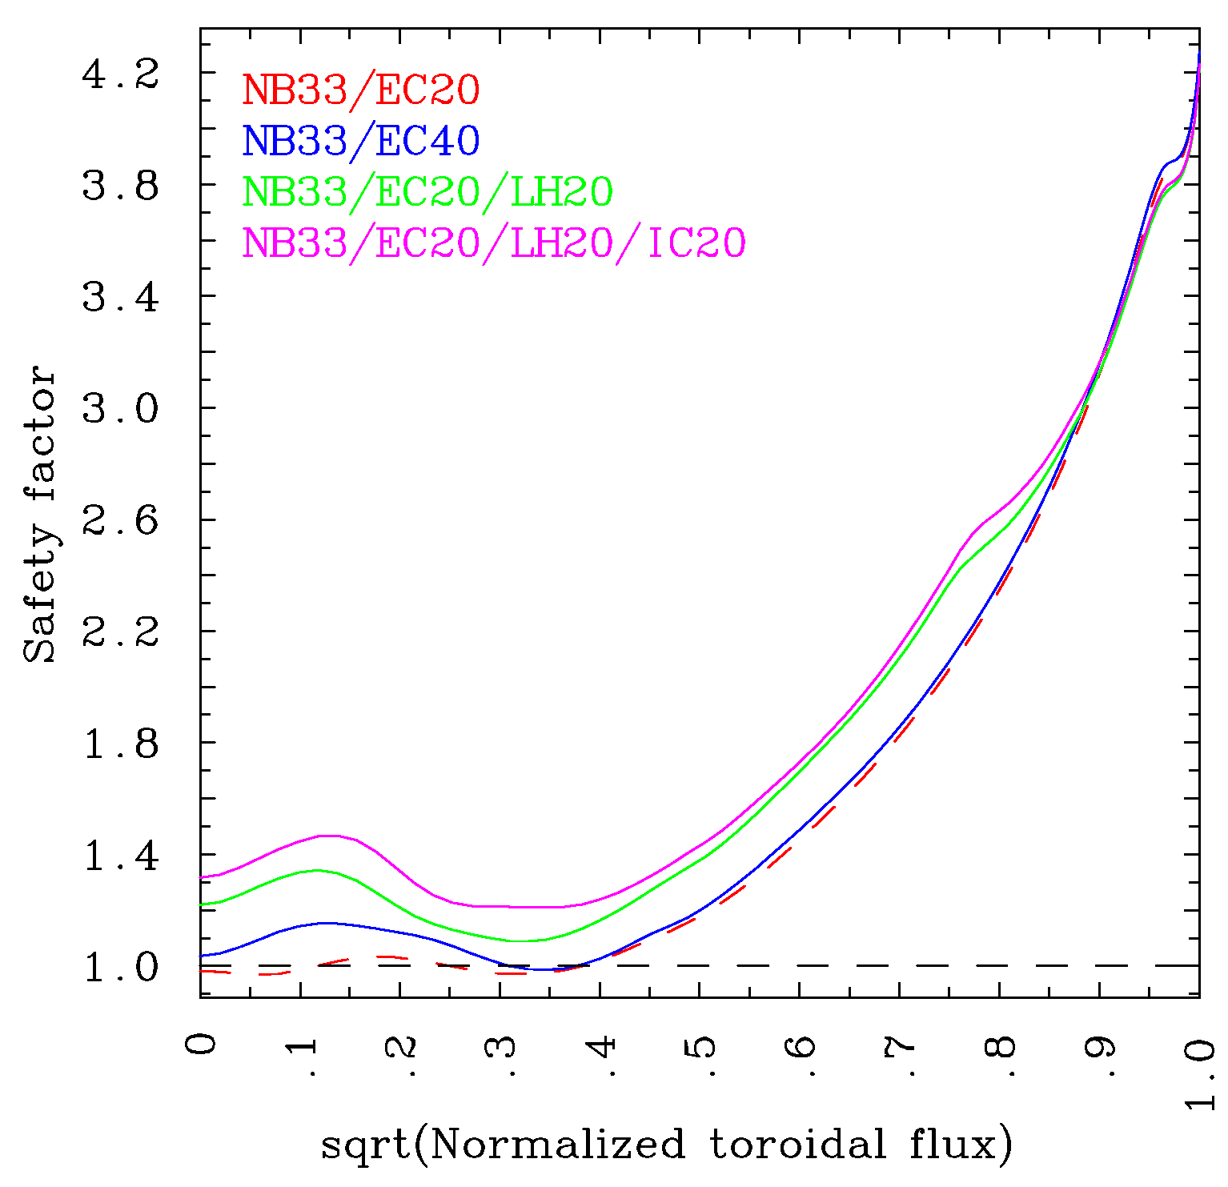
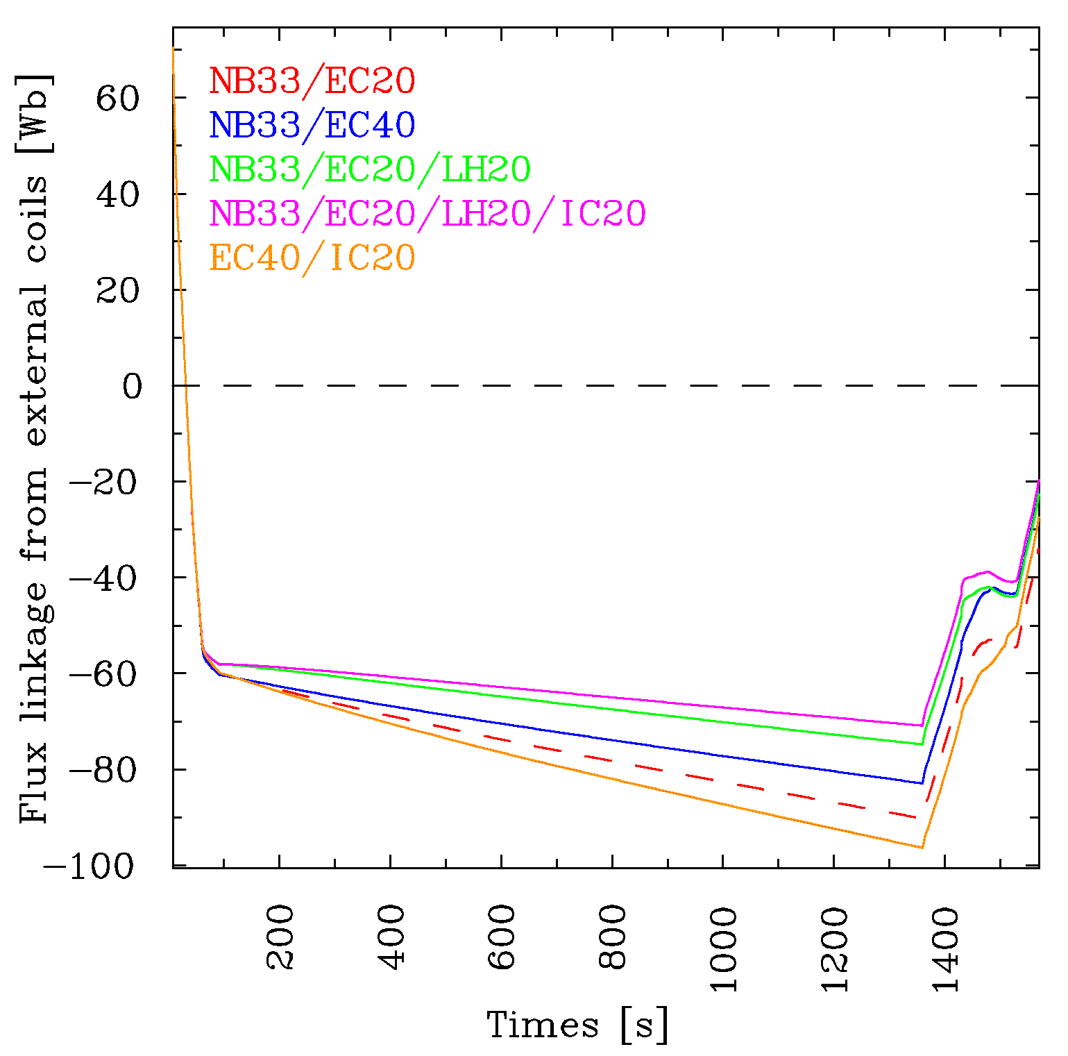
q profile evolution & Flux consumption
t=1359s
Higher non-inductively driven current and heat deposition
higher q values with LH driven off-axis currents, q>1 until the end of flat-top
less flux consumption and resulting modifications on coil current evolutions
Higher power but less driven current (EC40/IC20 case) ➔ more flux consumption

Slide 14
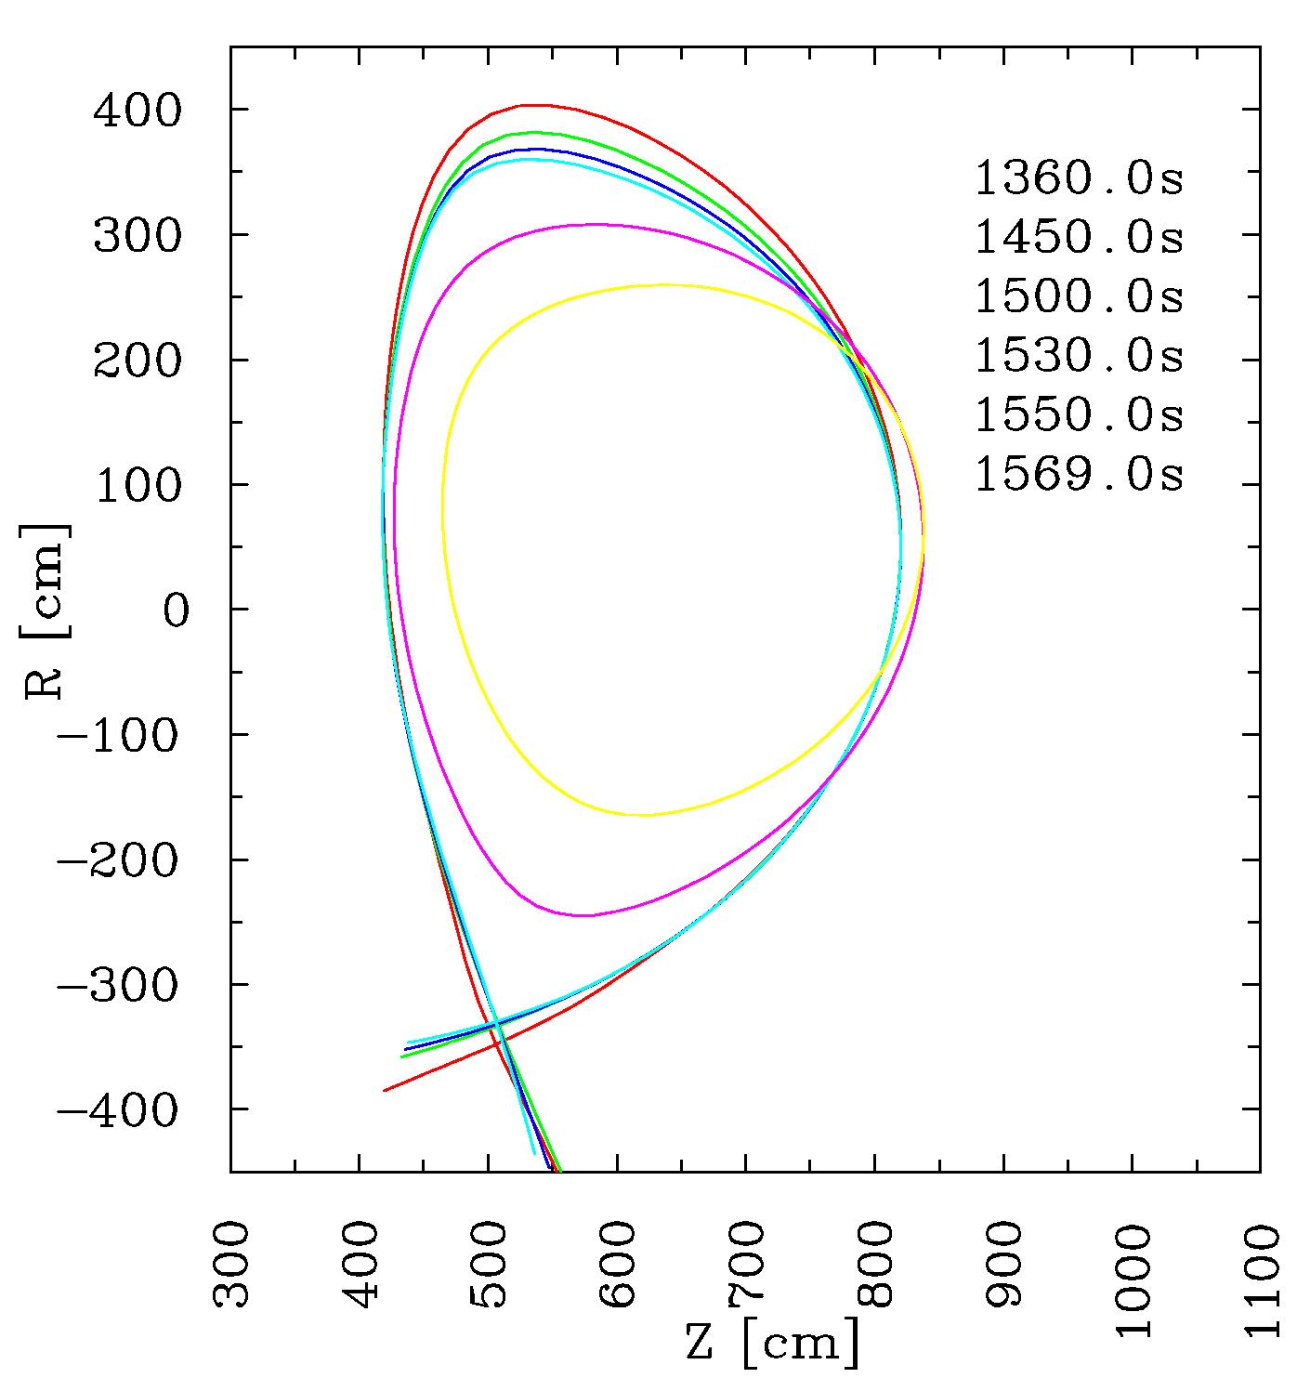
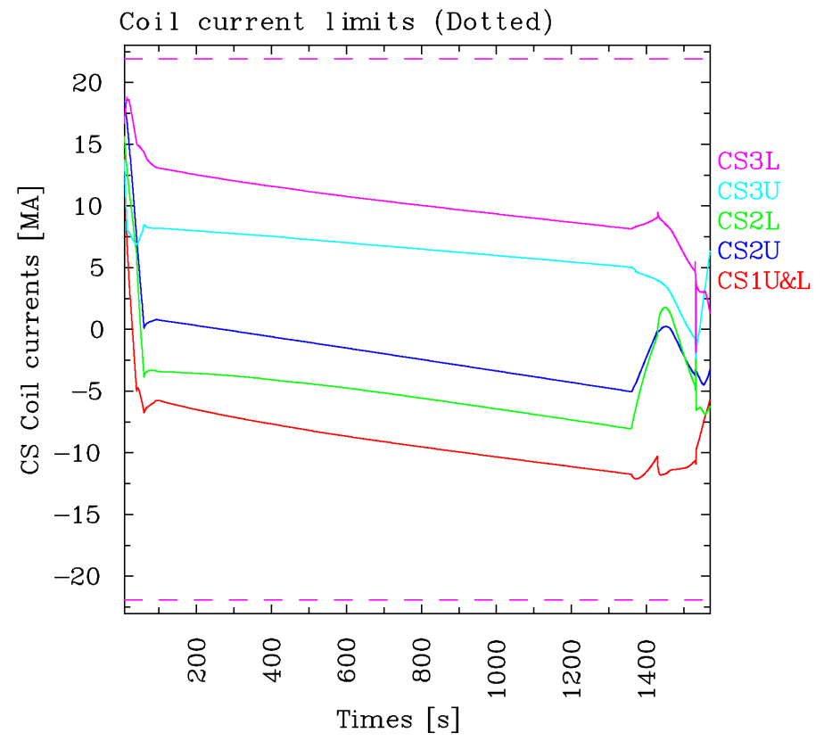
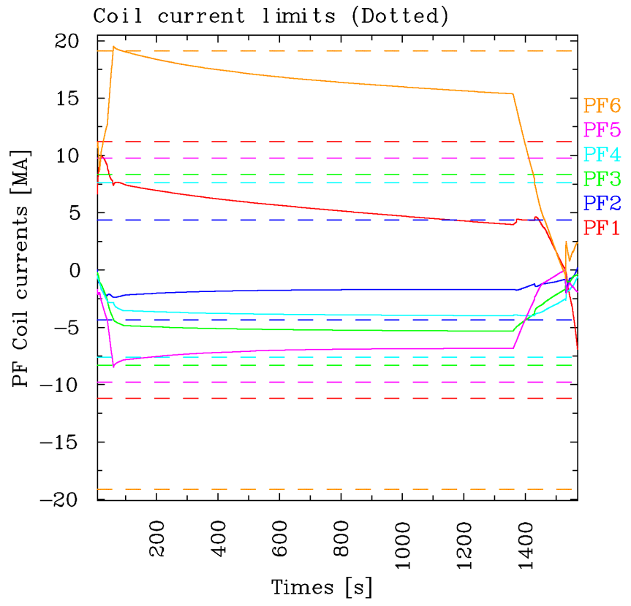
Ramp-down shape evolution
Application of different shape evolution during the ramp-down phase ➔ No violation of coil current, field, force and imbalance current limits
Difficulties on positioning the sources (too peaked current profile)
Limited or diverted configuration ?

Slide 15
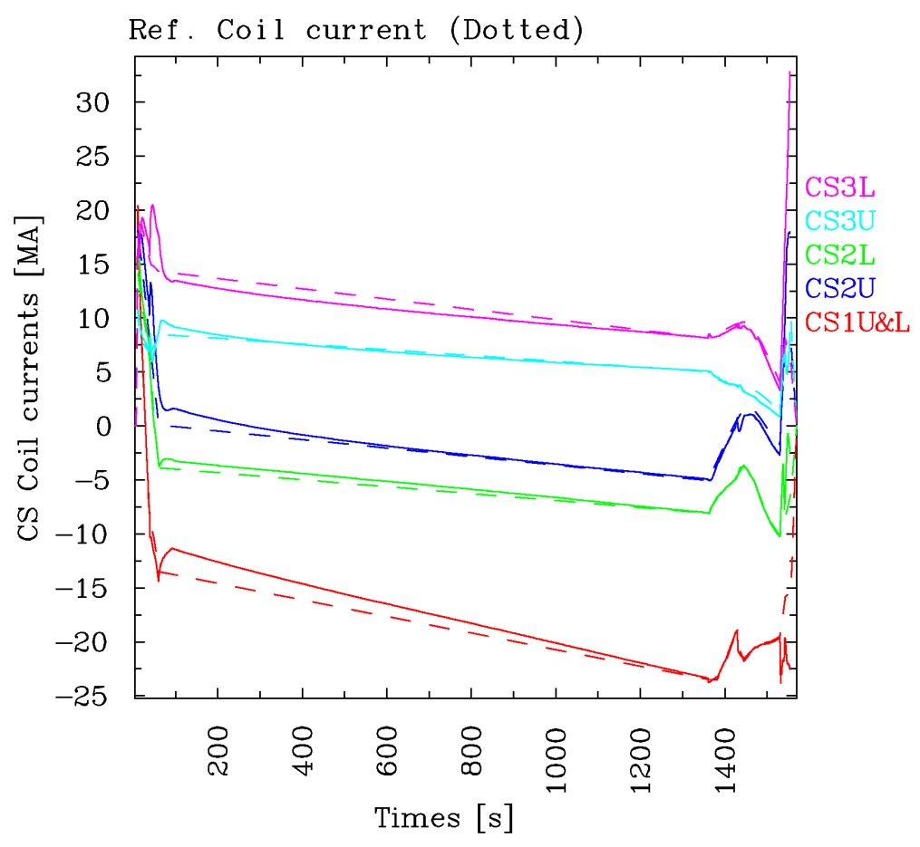
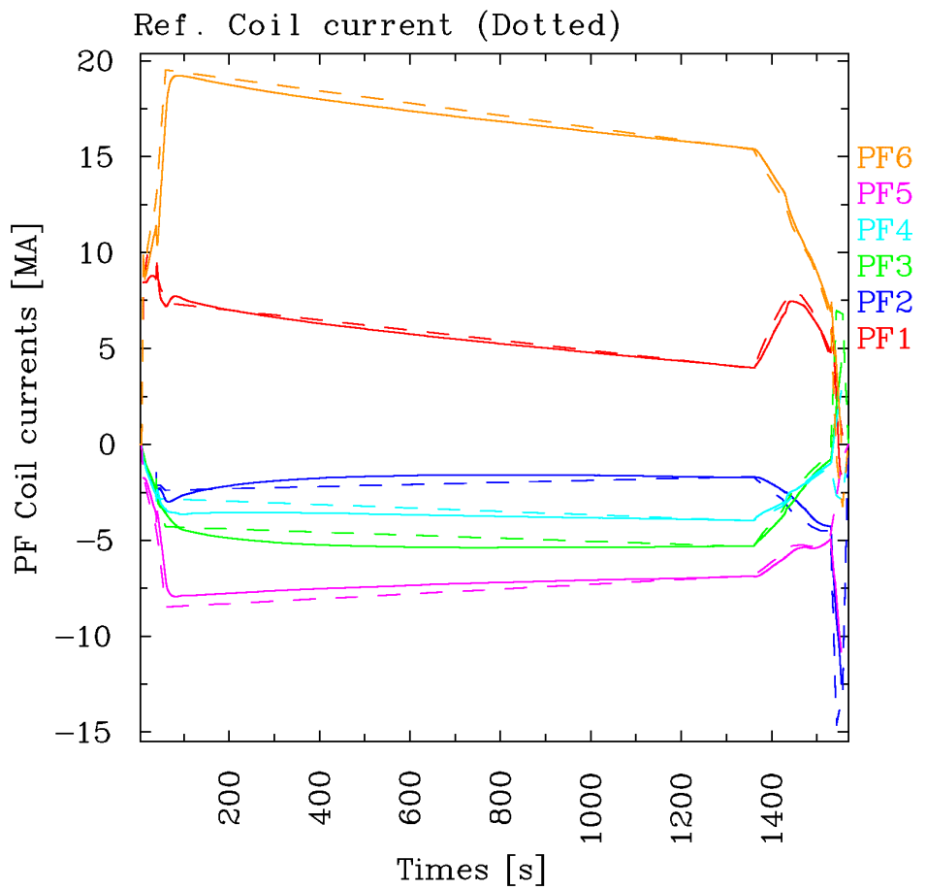
Forward simulation of the reference case
Forward simulation has been done using the reference coil current obtained from a backing out simulation (I_{CS1} = I_{CS1U}+I_{CS1L}, I_{PF6} is OK with UFC criteria, PCS might handle I_{PF2} @ I_{p}~3.5MA with P_{aux}=0W).
Coil voltages are computed using the ITER controllers (JCT2001 + VS1) and power supply models.
2
1
3

Slide 16
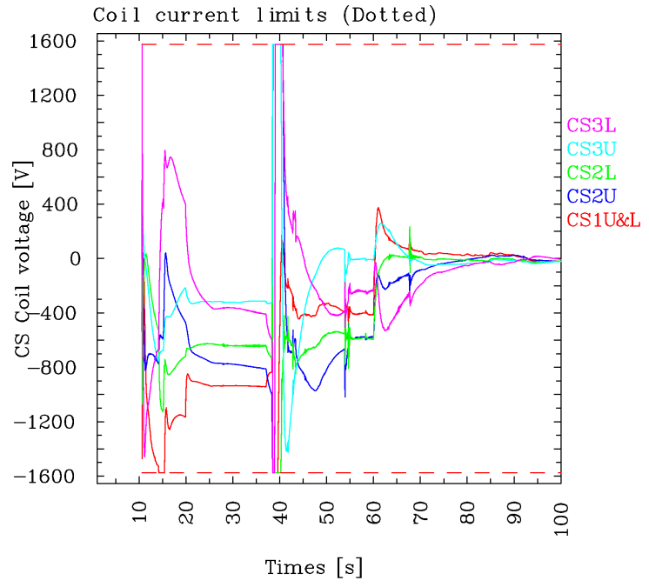
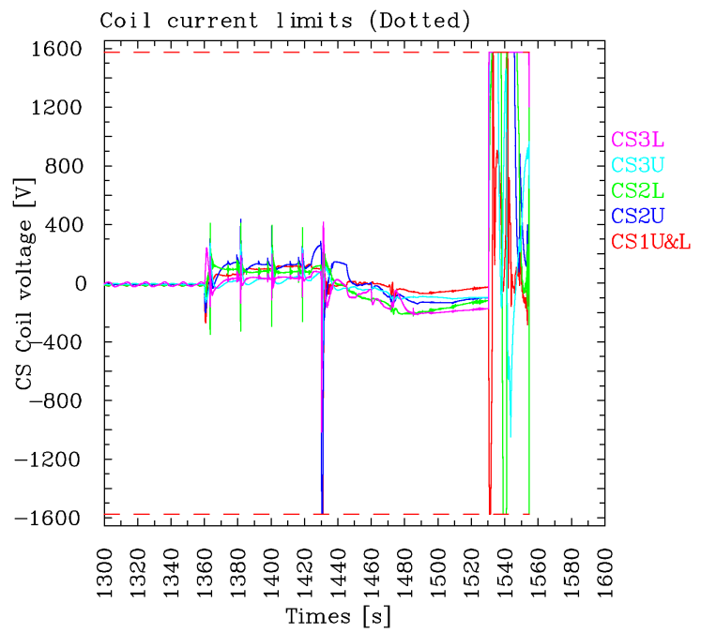
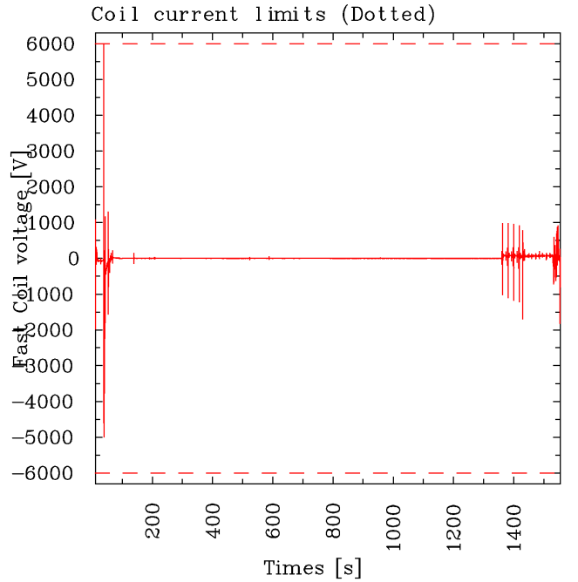
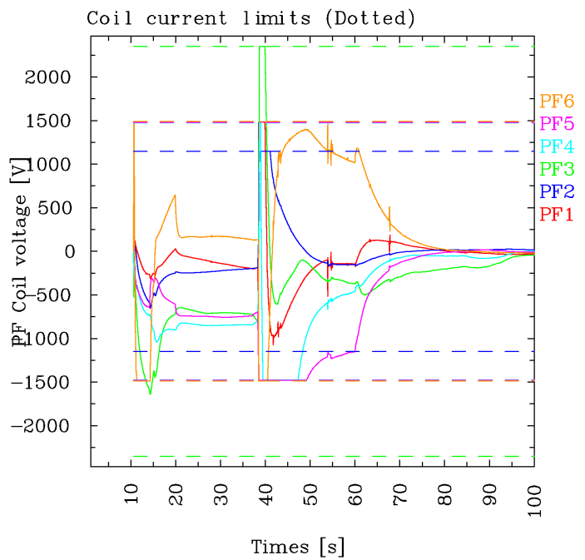
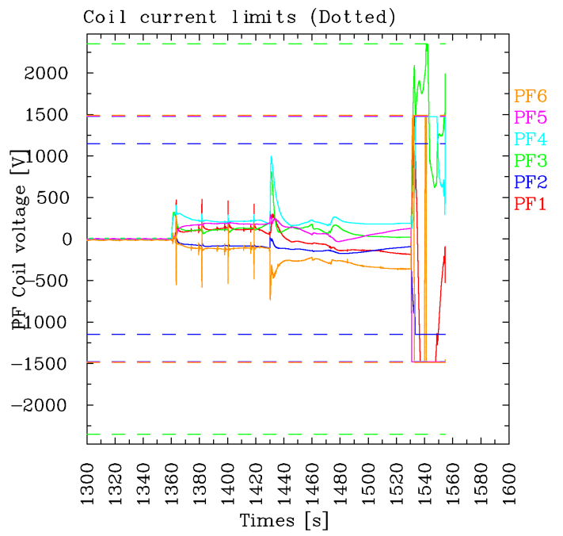
Voltage evolution
Saturation voltage per turn is used for slow controller, whereas VS1 uses the total saturation voltage, 6kV.
Each coil and saturation voltages are multiplied by its coil turns for plotting (might be not exact)

Slide 17
Summary and perspectives
ITER hybrid operation scenario has been simulated using Corsica and realistic source modules.
Operation space study with different conditions
Studying optimum source combinations for achieving q>1 condition
Additional source/pedestal modules
Official version of TORIC (IPP)
IC module in ACCOME (long-term ?)
A pedestal model based on stability analysis
ITER steady-state operation scenario modelling
Developing ITER steady-state operation scenarios
Studying physics issues related to the steady-state operation and ITBs
Investigating requirements for ITER H&CD systems
Support ITER PCS and IM projects
ISM relevant joint activity ?

Slide 18
Additional slides
1.0

Slide 19
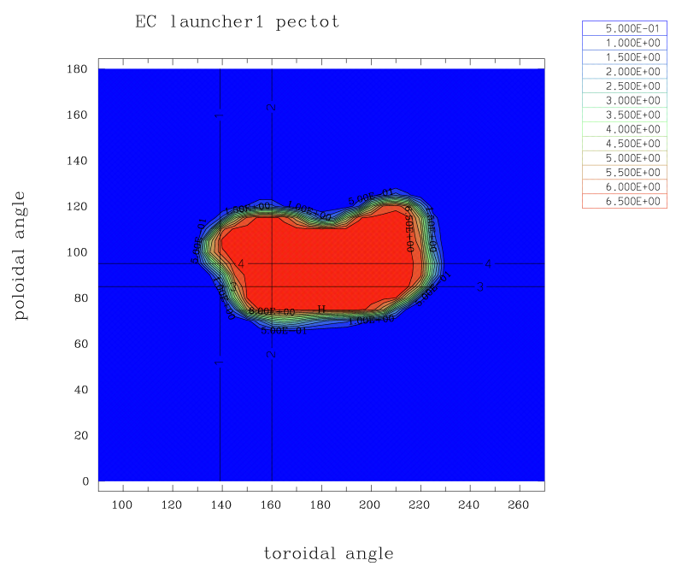
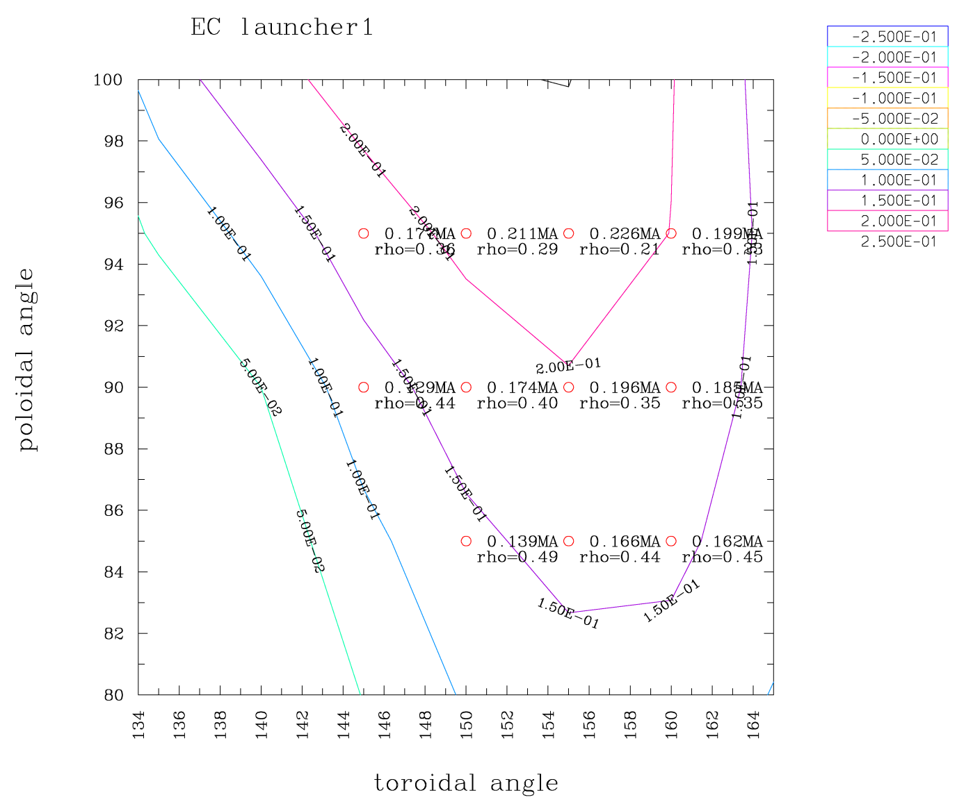
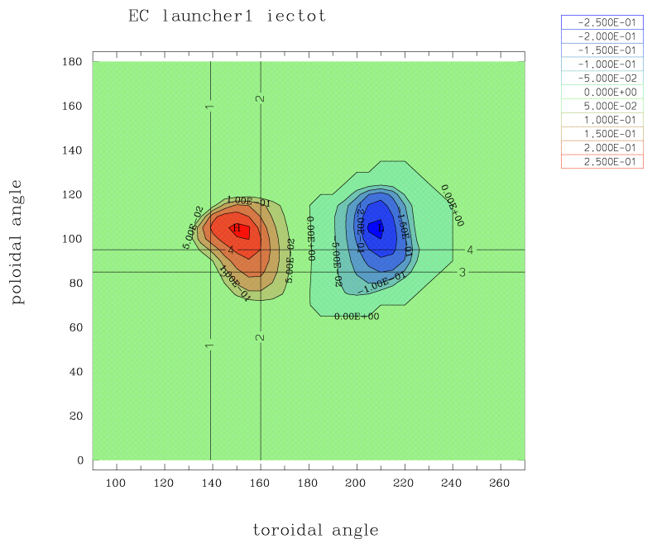
Automatic scan on EC angles
Automated suggestion for mirror angles of EL^{upper}
P_{e, EC}
Off-axis
J_{EC}
High J_{EC}

Slide 20
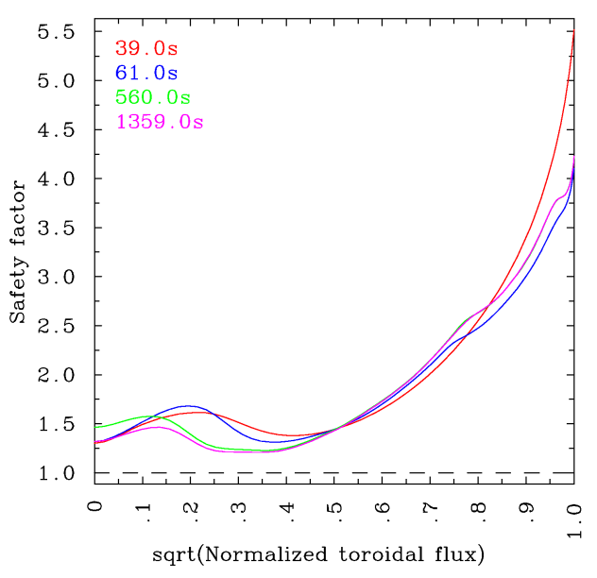
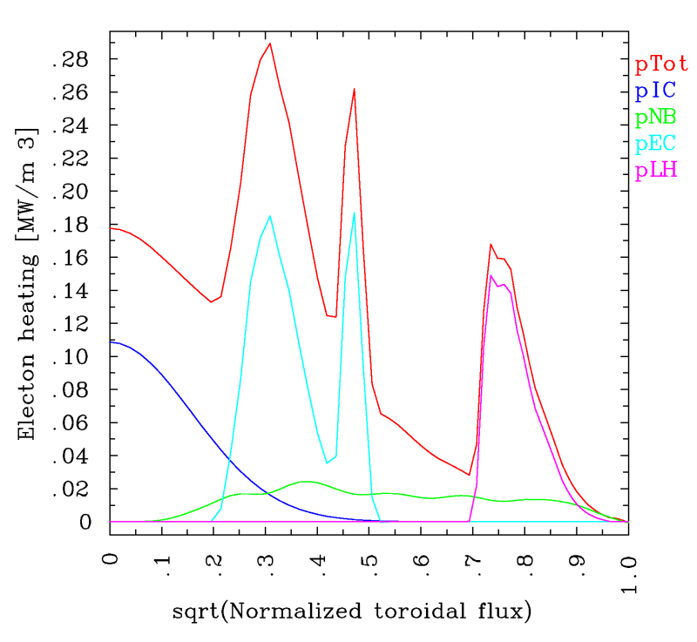
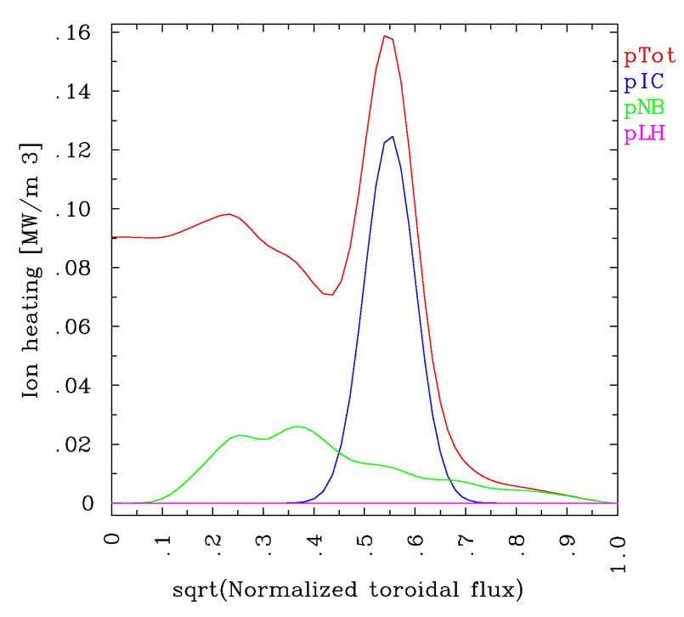
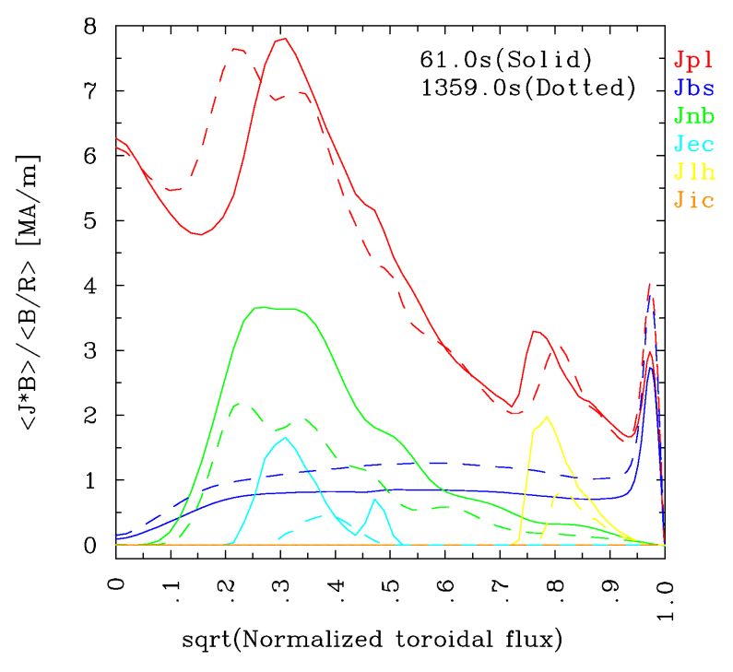
Realistic source profiles
NB33/EC20/LH20/IC20 case
NB : 33MW, off-axis
EC : 20MW, off-axis, election heating
IC : 20MW, 46MHz (J. Garcia, on-axis P_{e} & off-axis P_{i}) / 53MHz (on-axis P_{e} & P_{i}) , prescribed heat deposition porifiles, no driven current
LH : 20MW, n||=2.2(C. Kessel), far off-axis
t=60s
t=60s

Slide 21
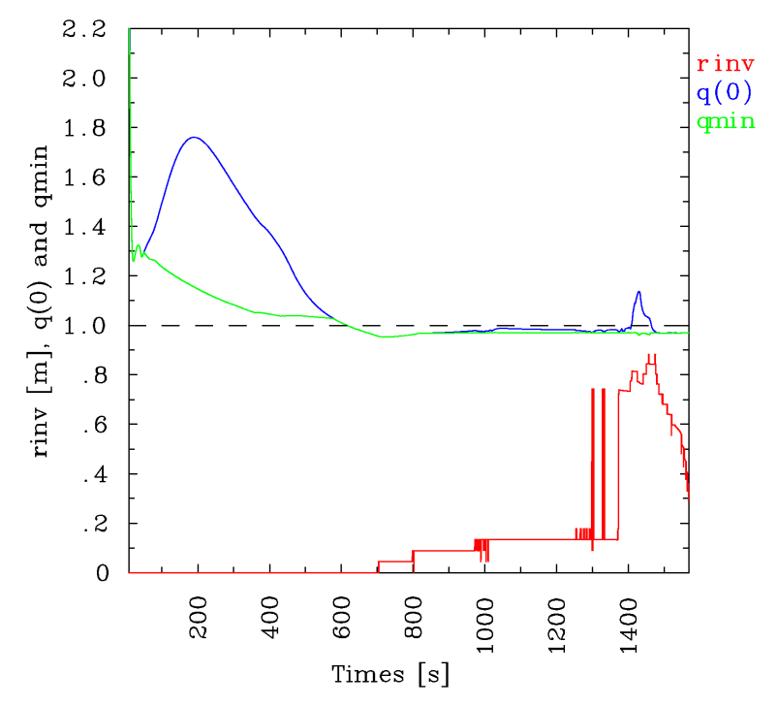
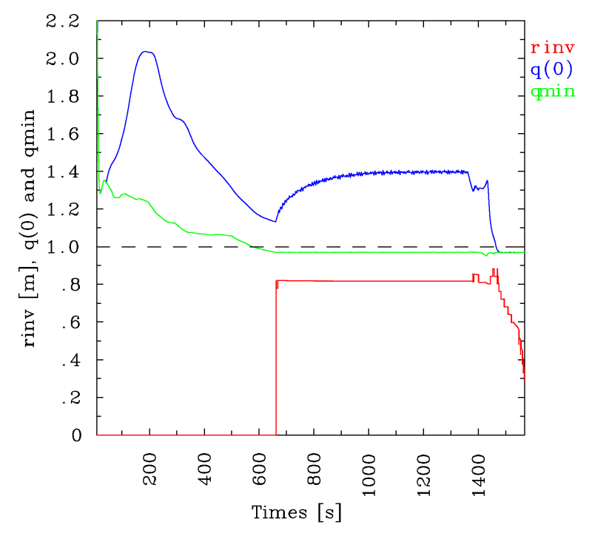
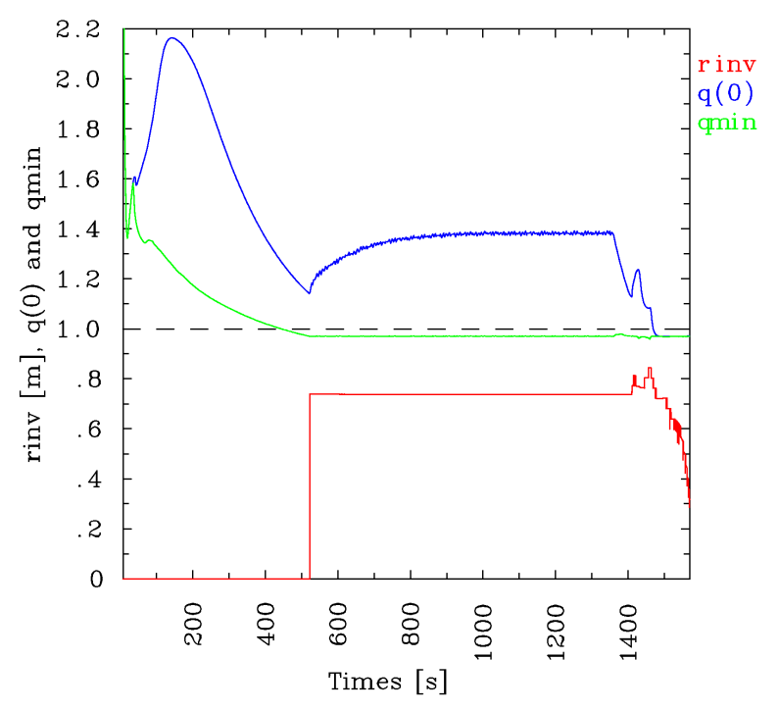
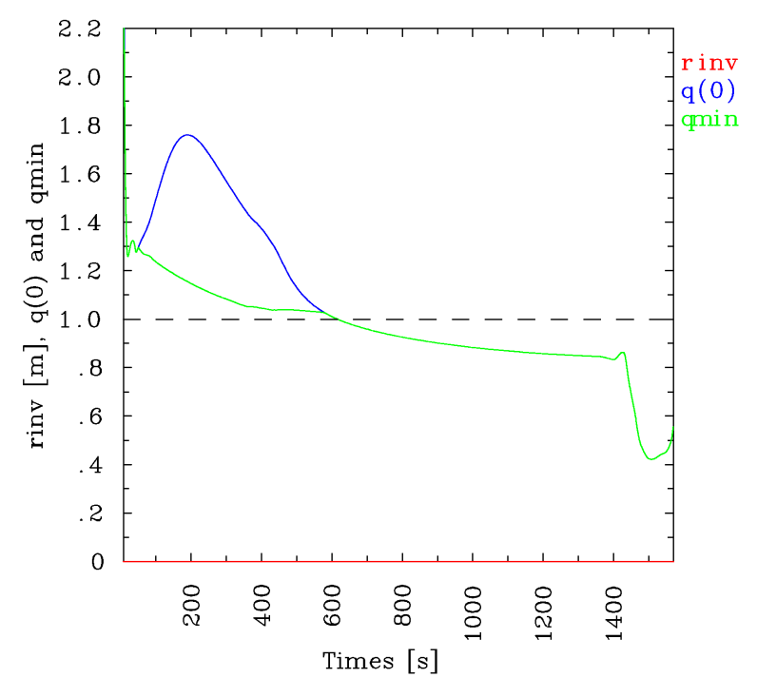
Central q behaviours
Reference case
Low density case
Low H-mode confinement case
No sawteeth case
Effective sawteeth increased the plasma resistivity inside the inversion radius ➔ q(0)>1.0
Large jumps at the start of Sawteeth, due to already slightly reversed q profiles
(a)
(b)
(c)
(d)

Slide 22
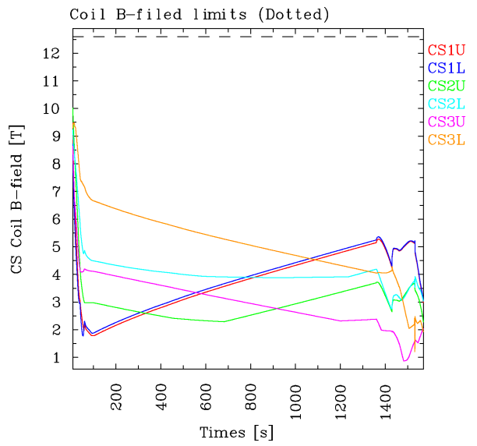
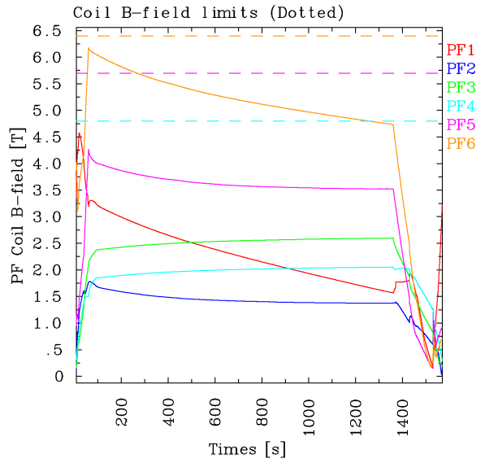
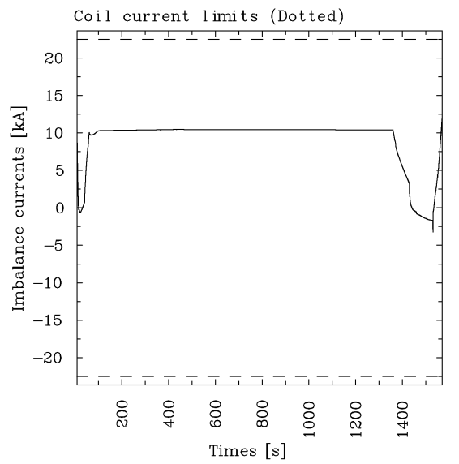
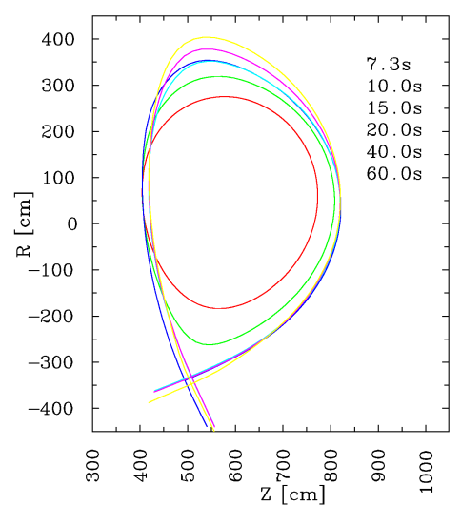
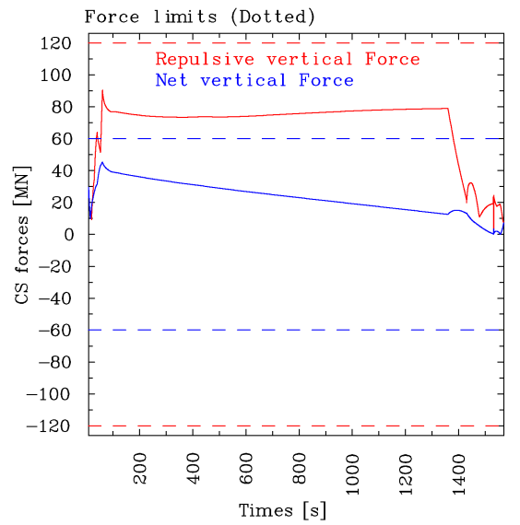
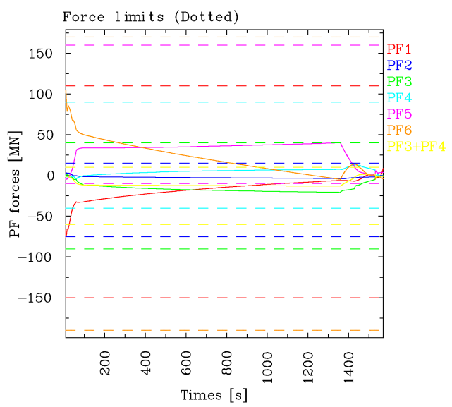
Ramp-down shape evolution - limits
No violation of coil current, field, force and imbalance current limits

